Slide 1
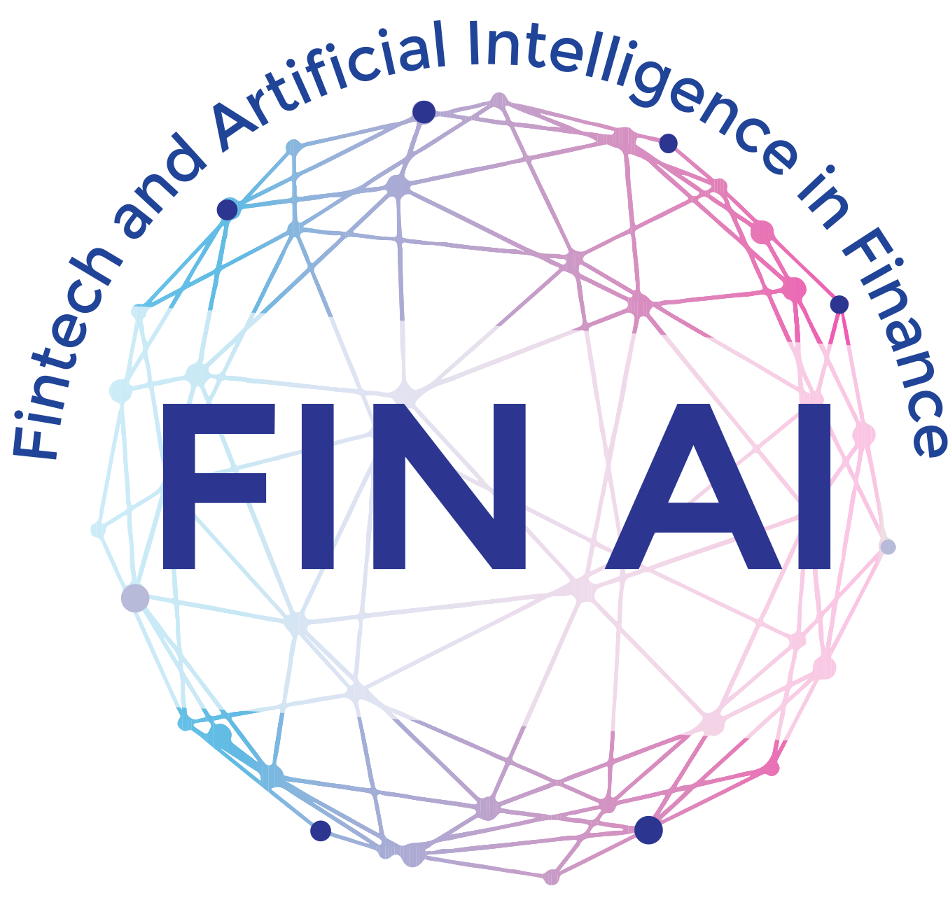
Country update
Ireland
Fintech and Artificial Intelligence in Finance –
Towards a transparent financial industry
EU COST Action CA19130

Slide 2
Activities I – ML and cryptos
As the Irish node, we have continued working mainly on the papers linked with the policy-oriented events we held last year in Brussels and in the Azores. See for example the following:
  “Assessing AI and Data Protection Expertise in Academia and the Financial Sector: Insights and Recommendations for AI Skills Development” (with Maria Moloney, Ekaterina Svetlova, Cal Muckley, Eleftheria G. Paschalidou, Ioana Coita), Journal of Financial Transformation 58, November 2023;
  https://www.capco.com/-/media/4C983F38515E4D16A0D84E0E248913D7.ashx
We are also working on what we call “Narrative Finance”, which is related to the AI/ML aspects of the Action, mainly with the following two working papers:
  “Bubbles Talk: Narrative Augmented Bubble Prediction”, with Y. Chen and D. Bredin, Michael J. Brennan Irish Finance Working Paper Series Research Paper No. 23-5, 2024.
  “Fed Put in the Equity Options Markets”, with Dahiya, S., Kamrad, B., A.R. Siddique, Michael J. Brennan Irish Finance Working Paper Series Research Paper No. 22-11, 2024.
Other work related to the topics of the Action includes papers on cryptos, such as:
  “Crypto-environment network connectivity and Bitcoin returns distribution tail behaviour”, with R. Caferra and A. Morone, Economics Letters 218, 2022.

Slide 3
Activities II - diversity
We were also active on topics and activities related to diversity, which lead among others to the following working papers:
  Pisoni, G., Paccagnini, A., Tarantola, C., Tanda, A., Shala, A. and Meriem, K., 2022. SI women in Fintech and AI. Digital Finance, 4(4), pp.263-264.
  Barbara Będowska-Sójka, Claudia Tarantola, Codruta Mare, Alessia Paccagnini, Belma Ozturkkal, Galena Pisoni, Rezarta Perri,
  Albulena Shala, and Hanna Kristín Skaftadóttir, 2024. Editorial Boards of Finance Journals: The Gender Gap and Social Network, working paper under revision to a journal
  Agarwal, S., Muckley, C. B., & Neelakantan, P. (2023). Countering racial discrimination in algorithmic lending: A case for model-agnostic interpretation methods. Economics letters, 226, 111117.
  Conlon, T., Huan, X., & Muckley, C. B. (2024). Does national culture influence malfeasance in banks around the world?. Journal of International Financial Markets, Institutions and Money, 90, 101888.
  Agarwal, S., & Muckley, C. B. (2024). Money Management Difficulties and Older People: Detection of Early-stage Dementia in Financial Data. Available at SSRN 4785764.

